Slide 1
What Is Security?
Security is a measurement, not a characteristic.
It is unfortunate that many software projects list security as a simple requirement to be met. Is it secure? This question is as subjective as asking if something is hot.
Security must be balanced with expense.
It is easy and relatively inexpensive to provide a sufficient level of security for most applications. However, if your security needs are very demanding, because you're protecting information that is very valuable, then you must achieve a higher level of security at an increased cost. This expense must be included in the budget of the project.
Security must be balanced with usability.
It is not uncommon that steps taken to increase the security of a web application also decrease the usability. Passwords, session timeouts, and access control all create obstacles for a legitimate user. Sometimes these are necessary to provide adequate security, but there isn't one solution that is appropriate for every application. It is wise to be mindful of your legitimate users as you implement security measures.
Security must be part of the design.
If you do not design your application with security in mind, you are doomed to be constantly addressing new security vulnerabilities. Careful programming cannot make up for a poor design.

Slide 2
Register Globals
The register_globals directive is disabled by default in PHP versions 4.2.0 and greater. While it does not represent a security vulnerability, it is a security risk. Therefore, you should always develop and deploy applications with register_globals disabled.
Why is it a security risk? Good examples are difficult to produce for everyone, because it often requires a unique situation to make the risk clear. However, the most common example is that found in the PHP manual:
<?php
if (authenticated_user())
{
$authorized = true;
}
if ($authorized)
{
include '/highly/sensitive/data.php';
}
?>
With register_globals enabled, this page can be requested with ?authorized=1 in the query string to bypass the intended access control. Of course, this particular vulnerability is the fault of the developer, not register_globals, but this indicates the increased risk posed by the directive. Without it, ordinary global variables (such as $authorized in the example) are not affected by data submitted by the client. A best practice is to initialize all variables and to develop with error_reporting set to E_ALL, so that the use of an uninitialized variable won't be overlooked during development.

Slide 3
Error Handling
When creating scripts and web applications, error handling is an important part. If your code lacks error checking code, your program may look very unprofessional and you may be open to security risks.
We will discuss some of the most common error checking methods in PHP.
We will show different error handling methods:
Simple "die()" statements
Custom errors and error triggers
Error reporting

Slide 4
Basic Error Handling: Using the die() function
The first example shows a simple script that opens a text file:
<?php $file=fopen("welcome.txt","r"); ?>
If the file does not exist you might get an error like this:
Warning: fopen(welcome.txt) [function.fopen]: failed to open stream: No such file or directory in C:\webfolder\test.php on line 2
To prevent the user from getting an error message like the one above, we test whether the file exist before we try to access it:
<?php if(!file_exists("welcome.txt")) { die("File not found"); } else { $file=fopen("welcome.txt","r"); } ?>
Now if the file does not exist you get an error like this:
File not found
The code above is more efficient than the earlier code, because it uses a simple error handling mechanism to stop the script after the error.
However, simply stopping the script is not always the right way to go. Let's take a look at alternative PHP functions for handling errors.

Slide 5
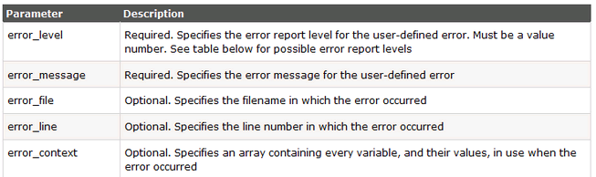
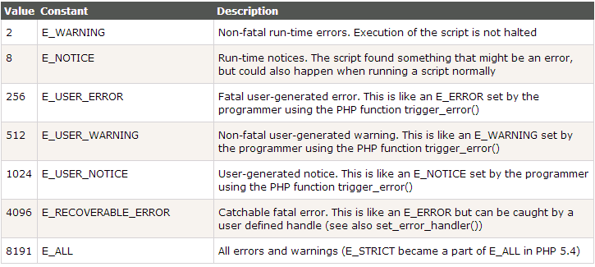
Basic Error Handling: Custom Error Handler
Creating a custom error handler is quite simple. We simply create a special function that can be called when an error occurs in PHP.
This function must be able to handle a minimum of two parameters (error level and error message) but can accept up to five parameters (optionally: file, line-number, and the error context):
Syntax
error_function(error_level,error_message, error_file,error_line,error_context)
Error Report levels
These error report levels are the different types of error the user-defined error handler can be used for:

Slide 6
Basic Error Handling: Custom Error Handler
Now lets create a function to handle errors:
function customError($errno, $errstr) { echo "<b>Error:</b> [$errno] $errstr<br>"; echo "Ending Script"; die(); }
The code above is a simple error handling function. When it is triggered, it gets the error level and an error message. It then outputs the error level and message and terminates the script.
Now that we have created an error handling function we need to decide when it should be triggered.
Set Error Handler
The default error handler for PHP is the built in error handler. We are going to make the function above the default error handler for the duration of the script.
It is possible to change the error handler to apply for only some errors, that way the script can handle different errors in different ways. However, in this example we are going to use our custom error handler for all errors:
set_error_handler("customError");
Since we want our custom function to handle all errors, the set_error_handler() only needed one parameter, a second parameter could be added to specify an error level.
Example
Testing the error handler by trying to output variable that does not exist:
<?php //error handler function function customError($errno, $errstr) { echo "<b>Error:</b> [$errno] $errstr"; } //set error handler set_error_handler("customError"); //trigger error echo($test); ?>
The output of the code above should be something like this:
Error: [8] Undefined variable: test

Slide 7
Basic Error Handling: Set Error Handler
Trigger an Error
In a script where users can input data it is useful to trigger errors when an illegal input occurs. In PHP, this is done by the trigger_error() function.
Example
In this example an error occurs if the "test" variable is bigger than "1":
<?php $test=2; if ($test>1) { trigger_error("Value must be 1 or below"); } ?>
The output of the code above should be something like this:
Notice: Value must be 1 or below in C:\webfolder\test.php on line 6
An error can be triggered anywhere you wish in a script, and by adding a second parameter, you can specify what error level is triggered.
Possible error types:
E_USER_ERROR - Fatal user-generated run-time error. Errors that can not be recovered from. Execution of the script is halted
E_USER_WARNING - Non-fatal user-generated run-time warning. Execution of the script is not halted
E_USER_NOTICE - Default. User-generated run-time notice. The script found something that might be an error, but could also happen when running a script normally
Example
In this example an E_USER_WARNING occurs if the "test" variable is bigger than "1". If an E_USER_WARNING occurs we will use our custom error handler and end the script:
<?php //error handler function function customError($errno, $errstr) { echo "<b>Error:</b> [$errno] $errstr<br>"; echo "Ending Script"; die(); } //set error handler set_error_handler("customError",E_USER_WARNING); //trigger error $test=2; if ($test>1) { trigger_error("Value must be 1 or below",E_USER_WARNING); } ?>
The output of the code above should be something like this:
Error: [512] Value must be 1 or below Ending Script
Now that we have learned to create our own errors and how to trigger them, lets take a look at error logging.

Slide 8
Basic Error Handling: Error Logging
By default, PHP sends an error log to the server's logging system or a file, depending on how the error_log configuration is set in the php.ini file. By using the error_log() function you can send error logs to a specified file or a remote destination.
Sending error messages to yourself by e-mail can be a good way of getting notified of specific errors.
Send an Error Message by E-Mail
In the example below we will send an e-mail with an error message and end the script, if a specific error occurs:
<?php //error handler function function customError($errno, $errstr) { echo "<b>Error:</b> [$errno] $errstr<br>"; echo "Webmaster has been notified"; error_log("Error: [$errno] $errstr",1, "someone@example.com","From: webmaster@example.com"); } //set error handler set_error_handler("customError",E_USER_WARNING); //trigger error $test=2; if ($test>1) { trigger_error("Value must be 1 or below",E_USER_WARNING); } ?>
The output of the code above should be something like this:
Error: [512] Value must be 1 or below Webmaster has been notified
And the mail received from the code above looks like this:
Error: [512] Value must be 1 or below
This should not be used with all errors. Regular errors should be logged on the server using the default PHP logging system.

Slide 9
PHP Data Filtering
Data validation is an integral part of working with forms. Not only can invalid submitted data lead to security problems, but it can also break your webpage. Today, we’ll take a look at how to remove illegal characters and validate data by using the “filter_var” function.

Slide 10
PHP Data Filtering
<?php
$sName = "";
$sEmail = "";
$sHomepage = "";
$sMessage = "";
if (isset($_POST['Submit'])) {
if ($_POST['name'] != "") {
$_POST['name'] = filter_var($_POST['name'], FILTER_SANITIZE_STRING);
if ($_POST['name'] == "") {
$errors .= 'Please enter a valid name.<br/><br/>';
}
} else {
$errors .= 'Please enter your name.<br/>';
}
if ($_POST['email'] != "") {
$email = filter_var($_POST['email'], FILTER_SANITIZE_EMAIL);
if (!filter_var($email, FILTER_VALIDATE_EMAIL)) {
$errors .= "$email is <strong>NOT</strong> a valid email address.<br/><br/>";
}
} else {
$errors .= 'Please enter your email address.<br/>';
}
if ($_POST['homepage'] != "") {
$homepage = filter_var($_POST['homepage'], FILTER_SANITIZE_URL);
if (!filter_var($homepage, FILTER_VALIDATE_URL)) {
$errors .= "$homepage is <strong>NOT</strong> a valid URL.<br/><br/>";
}
} else {
$errors .= 'Please enter your home page.<br/>';
}

Slide 11
PHP Data Filtering
if ($_POST['message'] != "") {
$_POST['message'] = filter_var($_POST['message'], FILTER_SANITIZE_STRING);
if ($_POST['message'] == "") {
$errors .= 'Please enter a message to send.<br/>';
}
} else {
$errors .= 'Please enter a message to send.<br/>';
}
if (!$errors) {
$mail_to = 'me@somewhere.com';
$subject = 'New Mail from Form Submission';
$message = 'From: ' . $_POST['name'] . "\n";
$message .= 'Email: ' . $_POST['email'] . "\n";
$message .= 'Homepage: ' . $_POST['homepage'] . "\n";
$message .= "Message:\n" . $_POST['message'] . "\n\n";
//mail($to, $subject, $message);
echo "Thank you for your email!<br/><br/>";
} else {
echo '<div style="color: red">' . $errors . '<br/></div>';
}
if (isset($_POST['name']))
$sName = $_POST['name'];
if (isset($_POST['email']))
$sEmail = $_POST['email'];
if (isset($_POST['homepage']))
$sHomepage = $_POST['homepage'];
if (isset($_POST['message']))
$sMessage = $_POST['message'];
}
?>
<form name="form1" method="post" action="form-email.php">
Name: <br/>
<input type="text" name="name" value="<?php echo $sName; ?>" size="50" /><br/><br/>
Email Address: <br/>
<input type="text" name="email" value="<?php echo $sEmail; ?>" size="50"/> <br/><br/>
Home Page: <br/>
<input type="text" name="homepage" value="<?php echo $sHomepage; ?>" size="50" /> <br/><br/>
Message: <br/>
<textarea name="message" rows="5" cols="50"><?php echo $sMessage; ?></textarea>
<br/>
<input type="submit" name="Submit" />
</form>

